Slide 1
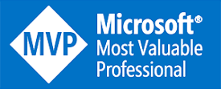
Data Engineering with Fabric
John Miner Data Architect
john.miner@insight.com

Slide 2
Purpose
Microsoft Fabric went to General Availability in November of 2023. How can we leverage this new service to solve out business problems?
Right now, there are four types of problems that can be solved with Fabric: lake house, data warehouse, data science and real time analytics.
Today, we are going to explore how you can use fabric within your organization.

Slide 3
Microsoft Fabric - Topics
Architecture Diagrams
One Lake
Data Warehouse
Real Time Analytics

Slide 4

Microsoft
Fabric
Architecture
Diagrams
Notes:
Now that we have covered Microsoft Fabric’s capabilities, let’s take a deeper dive into the Microsoft Fabric’s architecture by showcasing some of the most common end-to-end analytics scenarios and how the suite can be applied to each.

Slide 5

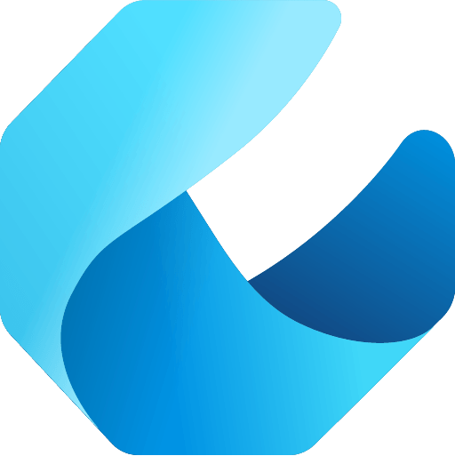

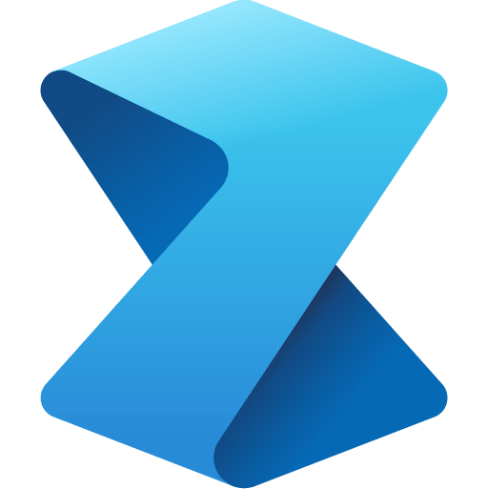

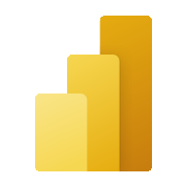
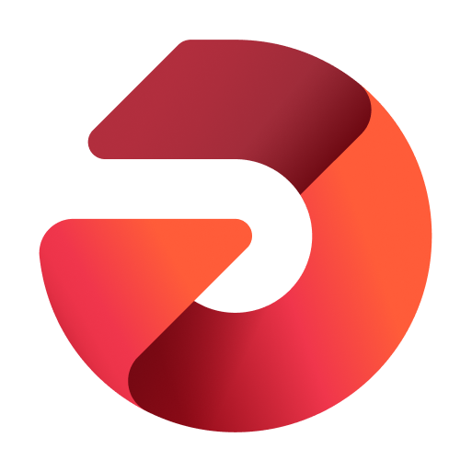

Microsoft Fabric is a unified solution
An end-to-end analytics platform that brings together all the data and analytics tools that organizations need to go from the data lake to the business user
Data Integration
Data Engineering
Data Warehouse
Data Science
Real Time Analytics
Business Intelligence
Observability
Data Factory
Synapse
Synapse
Synapse
Synapse
Power BI
Data Activator
Unified data foundation
OneLake
UNIFIED
SaaS product experience
Security and governance
Compute and storage
Business model
Notes:
Microsoft Fabric combines Data Factory, Synapse Analytics, Data Explorer, and Power BI into a single, unified experience, on the cloud. The open and governed data lakehouse foundation is a cost-effective and performance-optimized fabric for business intelligence, machine kerning, and AI workloads at any scale. It is the foundation for migrating and modernizing existing analytics solutions, whether this be data appliances or traditional data warehouses.
Talk Track for Greenfield/Growing Analytics Customers – Microsoft Fabric’s SaaS environment makes it easier to deploy an entire end-to-end analytics engine from the ground up at an accelerated pace. With the solution’s built-in security and governance capabilities, you can be rest assured your data and insights are protected.
Talk Track for Existing Synapse Customers – Microsoft Fabric is an evolution of Azure Synapse. You will still be able to enjoy the benefits and limitless scale of Synapse in an easier to use SaaS solution while adopting new capabilities that enhance your entire analytics approach. And with the addition of Power BI, you can help democratize the ability to uncover insights and create interactive reports across the organization, helping everyone make more data-driven decisions in their everyday work.
Talk Track for Existing Power BI Customers – With Microsoft Fabric, you’ll be able to access new and powerful data tools and services like Azure Synapse within the same user experience you already enjoy with Power BI. You can unify these tools with your disparate data sources in the same environment to establish a single source of truth for all data, driving the ability for everyone to uncover more accurate and consistent insights than before. And instead of having to worry about security concerns of a patchwork analytics estate, you can be rest assured your data is protected with the built-in security and governance capabilities.

Slide 6
Common analytics scenarios
Lakehouse
Data Warehouse
Data Science
Real Time Analytics
Notes:
Microsoft Fabric supports four common end-to-end analytics scenarios:
Lakehouse
Data Warehouse
Data Science
Real Time Analytics
Keep in mind that while these are the most common scenarios supported by Microsoft Fabric, there are many others that technical and business end-users can navigate through.

Slide 7
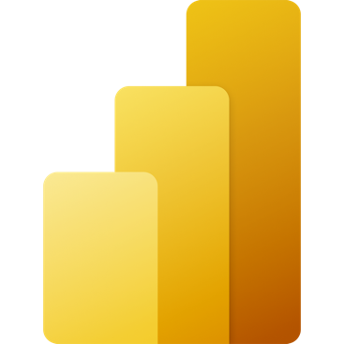
Lakehouse
Data Source
Ingestion
Store
Expose
Shortcut Enabled
Shortcuts
Lakehouse(s)
PBI
Structured / Unstructured
Pipelines & Dataflows
Lake Warehouse
Transform
Notebooks & Dataflows
Notes:
The Microsoft Fabric Lakehouse analytics scenario makes it so that data can be ingested into OneLake with shortcuts to other clouds repositories, pipelines, and dataflows in order to allow end-users to leverage other data.
Once that data has been pulled into Microsoft Fabric, users can leverage notebooks to transform that data in OneLake and then store them in Lakehouses with medallion structure.
From there, users can begin to analyze and visualize that data with Power BI using the see-through mode or SQL endpoints.

Slide 8
Data warehouse
Data Source
Ingestion
Store
Expose
Shortcut Enabled
Mounts
Data Warehouse
PBI
Structured / Unstructured
Pipelines & Dataflows
Warehouse
Transform
Procedures
Notes:
The Data Warehouse analytics scenario takes existing sources that are mounted, while pipelines and dataflows can bring in all other data that is needed.
IT teams can then define and store procedures to transform the data, which is stored as Parquet/Delta Lake files in OneLake.
From there, business users can analyze and visualize data with Power BI, again using the see-through mode or SQL endpoints.

Slide 9
Data science
Data Source
Clean & prepare
Store
Expose
Lakehouse & Data Warehouse
Notebooks
Lakehouse(s)
PBI
Train test & apply
Lake Warehouse
Models
Experiments
Notes:
The Data Science analytics scenario can be ingested similarly to the Lakehouse and Data Warehouse paths.
Once the data is ingested, it is cleaned and prepared using notebooks and then stored in the Lakehouse with medallion structure.
After the data is cleaned and stored, machine learning models can be trained and tested directly on the Lakehouse.
Like the other analytics scenarios, business users can analyze and visualize the data with Power BI using the see-through mode or SQL endpoints.

Slide 10
Real time analytics
Data Source
Ingestion
Store
Expose
Lakehouse & Data Warehouse
CI & Shortcuts
Kusto DB
PBI
Structured / Unstructured
Pipeline & Dataflows
Kusto Query
Event Streaming
Mirror
Notebook
Lakehouse & Data Warehouse
ML Model
Notes:
Unlike the Data Science, Lakehouse, and Data Warehouse analytics scenarios, streaming data can be ingested into the Microsoft Fabric in several ways to achieve real-time analytics.
Users can leverage Event Hub, IoT Hub, pipelines, dataflows, notebooks, or open-source products like Kafka, Logstash, and more.
Once ingested into the Microsoft Fabric, streaming data can be stored in Kusto DB and mirrored into Lakehouse. After the data has been stored, machine learning models can be trained and tested directly on the Lakehouse with experiments.
Like the other scenarios, business users can analyze and visualize the data with Power BI using the see-through mode or SQL endpoints. Data can also be exposed through KQL or notebooks using Spark.

Slide 11
Lakehouse
Apache Spark
Spark Clusters
Medallion Architecture
Data Ingestion
Data Engineering
Two examples

Slide 12
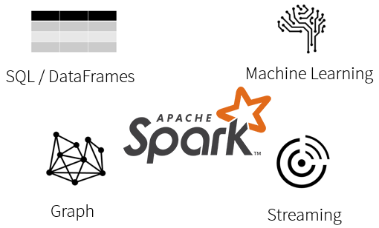
What is Spark?
Spark is a unified processing engine that can analyze big data using SQL, machine learning, graph processing or real-time stream analysis.

Slide 13
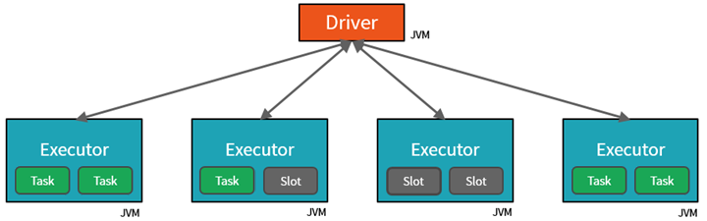
Spark Cluster
By creating Tasks, the Driver can assign units of work to Slots for parallel execution.
The Driver must also decide how to partition the data so that it can be distributed for parallel processing.
Fabric automatically has a starter cluster waiting for you to use!

Slide 14
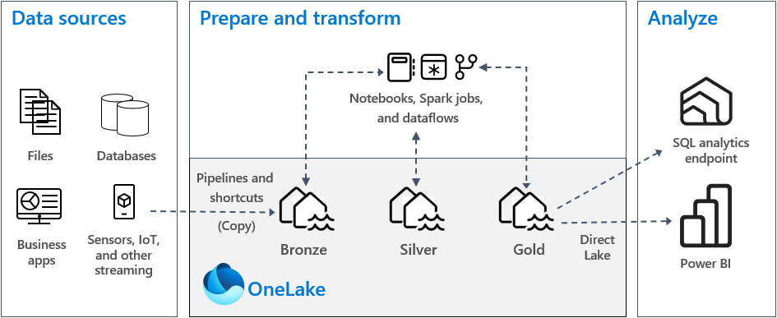
Medallion Architecture

Slide 15
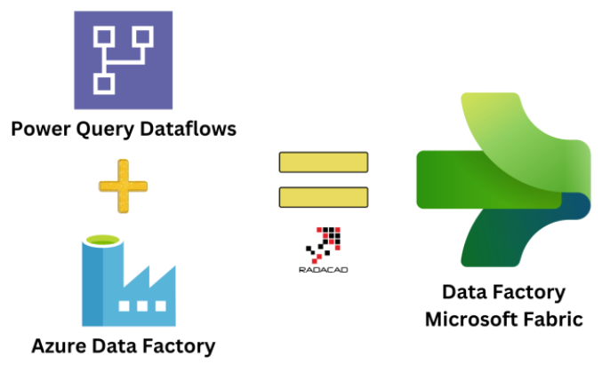
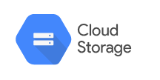
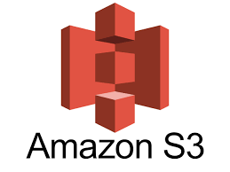
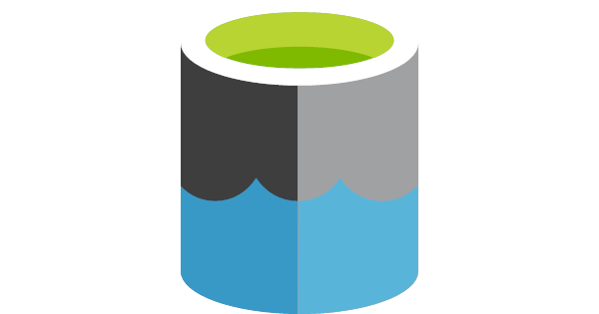
Data Ingestion
Data Factory can copy a variety of data from point a to b.
Shortcuts allow for data meshing. Look for egress charges.
Data Gateway is the key to on premise resources.
All tables are based on delta table format.
* Gateway is not available for all products yet.
Shortcuts = Data Meshing
ADLS Gen 2

Slide 16
Data Engineering
Fabric Data Factory supports wrangling data flows
Mapping data flows are not supported
Based upon Power Query
Parameterization is not easy
Spark notebooks are supported
New clusters are quick and reusable
Parameterization is easy
Scaling is controlled

Slide 17

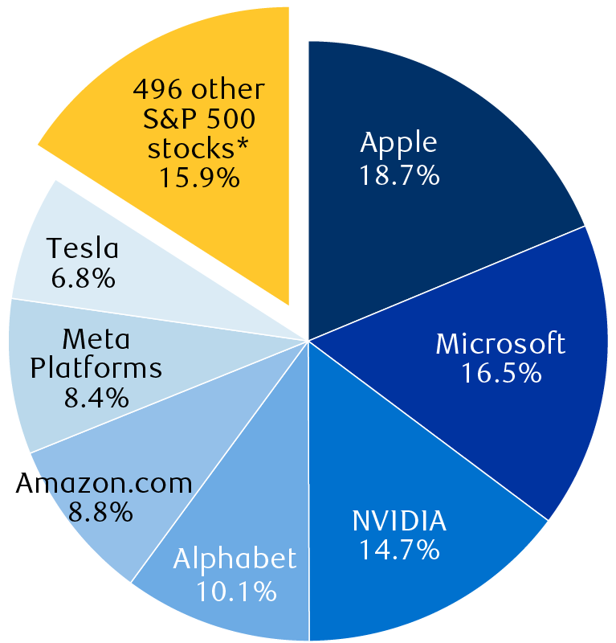
Examples
Ingest Adventure Works
Meta-data driven design
Uses both pipelines + notebooks
Data is copied into lake
Ingest Stock Data
Create shortcut
Tables or files appear
Use notebooks to transform

Slide 18
Warehouse
One Lake Uniform Architecture
Warehouse SQL Syntax
Two examples

Slide 19
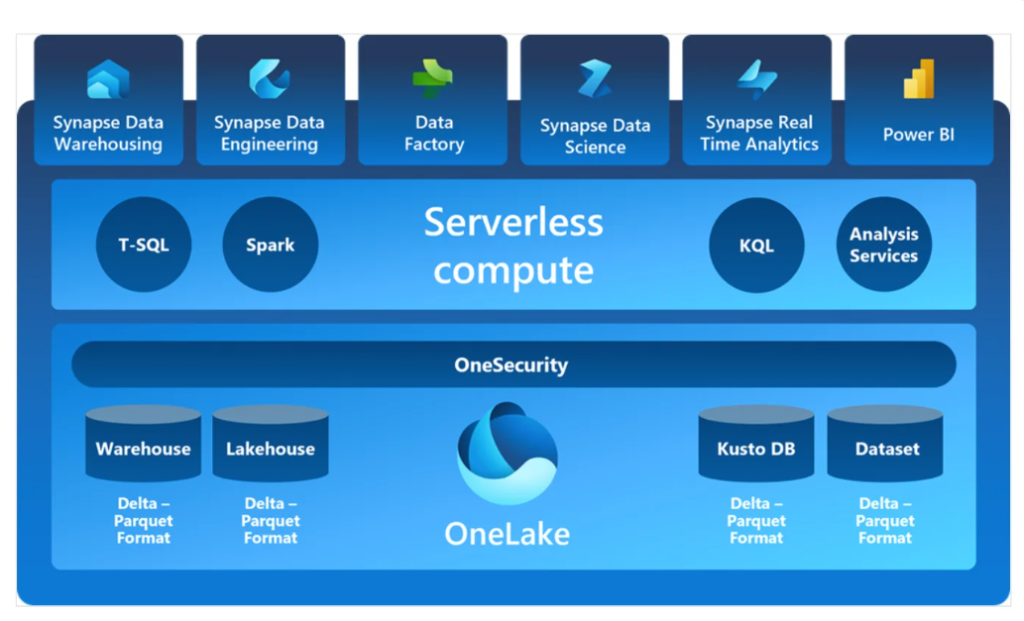
Delta Format @ Heart of One Lake

Slide 20
Warehouse SQL Syntax
Core objects ~ tables, views, functions, stored procedures
Default + check constraints are not supported.
Primary + Foreign key constraints not enforced.
No auto increment columns.
Alter table not supported.
Limited support for system views and procedures.
refer to documentation when developing
use data factory to ingest external data into tables
copy into syntax is supported for storage

Slide 21

Examples
Publishers Database
Was available in SQL Server 7.0
Reduced SQL syntax script
Ingest Stock Data
Create schema instead of database
Create table definition
Use COPY INTO to load hundreds of files

Slide 22
Kusto Database
Choose real time service
Valid sources for Kusto database
Two examples

Slide 23
Deployment Options
KQL Database
Load structured, unstructured and streaming data
Query the database with Kusto language
KQL Queryset
Run queries to produce shareable tables and visuals
Eventstream
Capture, transform and route real time data to various destinations

Slide 24
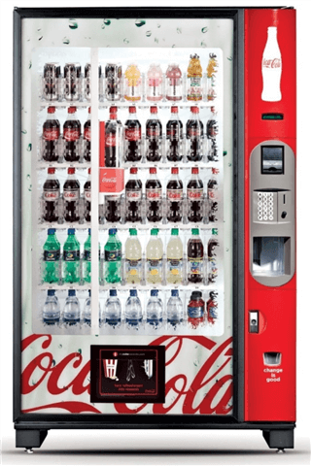
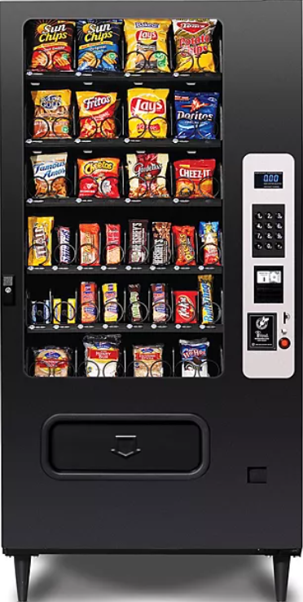
Examples
Soda Vendor
Create event hub
Produce sample json data
Load data into table
Snack Vendor
Create storage account + container
Produce sample Avro data from hub
Load data into table

Slide 25
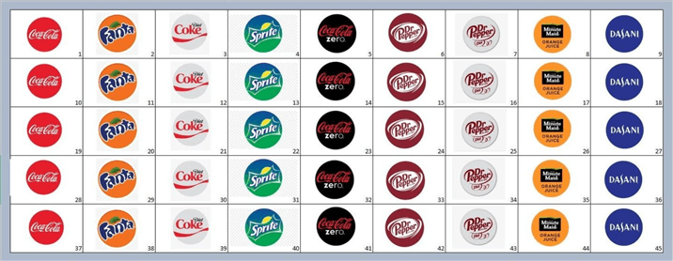
Products – Soda vs Snacks

Slide 26
Summary
Microsoft Fabric is the one stop shop for all your data and analytical needs. As a developer, you can pick an architecture using a lake house, data warehouse, machine learning, or Kusto database to solve real world problems.
What I did not show is how to use co-pilot to help code these solutions. The only draw back I see right now is the fact that co-pilot requires an F64 SKU which is around 8K per month. This is a high entry point for small to medium size customers.
During my exploration of the services, I logged several bugs. The road map for Fabric includes adding more sources to the lake as well as expanding on real time ingestion.
If you have your skill set includes SQL, Python and Spark, you should be right at home with the new product offerings. The future is bright for those who can adapt.

Slide 27
References
Fabric - Data Factory
https://tinyurl.com/y9r4ee7p
Fabric – Lake House
https://tinyurl.com/4fdk4bux
Fabric - Notebooks
https://tinyurl.com/5bydabub
Fabric – Data Warehouse
https://tinyurl.com/bdedrec4
Fabric – Kusto Database
https://tinyurl.com/bddhsr3y

Slide 28
Questions / Thank You

